Slide 1
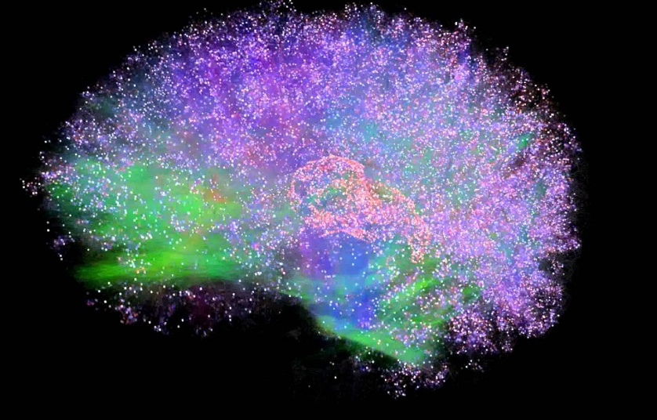
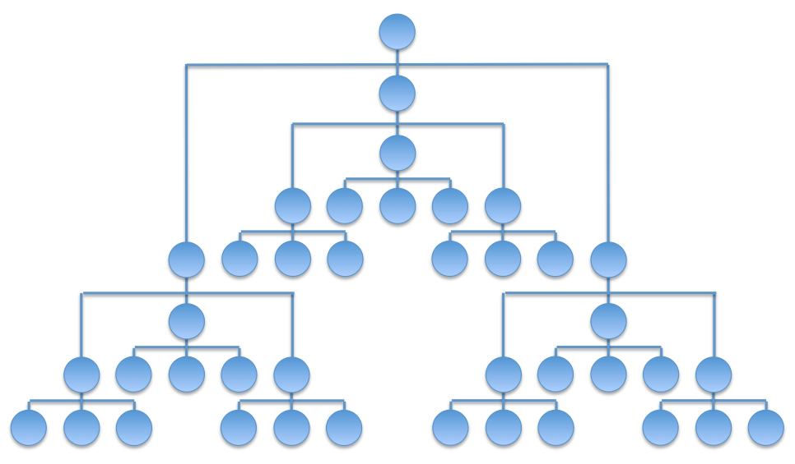
Integrated Information Theory for Organisational Consciousness
Jonathan Peters
Supervisors: Mariano Beguerisse, Christian Bick, Yakov Kremnitzer, Steve Brewis, Steve Cassidy

Slide 2
Integrated Information Theory
Properties of Consciousness
Existence
Composition
Information
Integration
Exclusion
RED

Slide 3
Mechanisms
A Or
B And
C Xor
Existence: The mechanism ABC exists.
Composition: The mechanism ABC is the composition of 3 smaller mechanisms: a 3rd order mechanism.

Slide 4

Transition Probability Matrix
$$T_{ij}=P(G^{t+1}=j|G^{t}=i)$$
ABC | 000 | 100 | 010 | 110 | 001 | 101 | 011 | 111
000 | 1 | 0 | 0 | 0 | 0 | 0 | 0 | 0
100 | 0 | 0 | 0 | 0 | 1 | 0 | 0 | 0
010 | 0 | 0 | 0 | 0 | 0 | 1 | 0 | 0
110 | 0 | 1 | 0 | 0 | 0 | 0 | 0 | 0
001 | 0 | 1 | 0 | 0 | 0 | 0 | 0 | 0
101 | 0 | 0 | 0 | 0 | 0 | 0 | 0 | 1
011 | 0 | 0 | 0 | 0 | 0 | 1 | 0 | 0
111 | 0 | 0 | 0 | 1 | 0 | 0 | 0 | 0

Slide 5
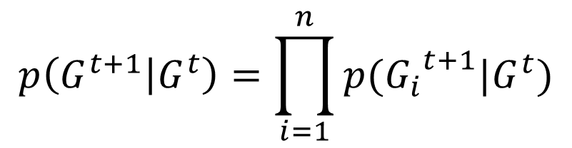

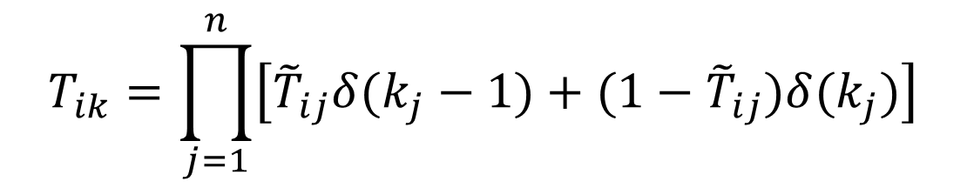
Transition Probability Matrix
$$p\left(G^{t+1} | G^{t}\right)=\prod_{i=1}^{n}{p({G_{i}}^{t+1}|G^{t})}$$
State | A | B | C
000 | 0 | 0 | 0
100 | 0 | 0 | 1
010 | 1 | 0 | 1
110 | 1 | 0 | 0
001 | 1 | 0 | 0
101 | 1 | 1 | 1
011 | 1 | 0 | 1
111 | 1 | 1 | 0
$${\tilde{T}}_{ij}=P({G_{j}}^{t+1}=1|G^{t}=i)$$
$$T_{ik}=\prod_{j=1}^{n}{\left[{\tilde{T}}_{ij}δ(k_{j}−1)+(1−{\tilde{T}}_{ij})δ(k_{j})\right]}$$

Slide 6
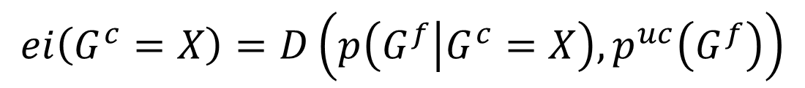
Information
Unconstrained Present
Known Present State
Unconstrained Future
Effect Repertoire
$$ei\left(G^{c}=X\right)=D\left(p\left(G^{f} | G^{c}=X\right), p^{uc}\left(G^{f}\right)\right)$$

Slide 7
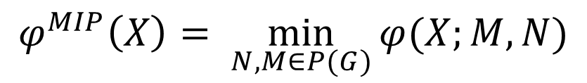

Integration
$${ABC}^{c}/{ABC}^{f}$$
A
A
A
A
B
B
VS
B
B
C
C
C
C
$$φ\left(X;M,N \right)=D\left(p\left(G^{f} | G^{c}=X\right),p\left(M^{f} | N^{c}=X_{N}\right)p\left({G\backslash M}^{f} | {G\backslash N}^{c}=X_{G\backslash N}\right)\right)$$
$$φ^{MIP}\left(X\right)= \min_{N,M∈P(G)}{φ(X;M,N)}$$

Slide 8

Exclusion
What is the core effect of ${AB}^{c}=01$?
A
A
B
B
C
C
Calculate $φ^{MIP}(01)$ for ${AB}^{c}/M^{p}$ for all $M∈P(G)$
The largest value of $φ^{MIP}(01)$ gives $φ^{MAX}\left(01\right).$

Slide 9
Concepts
I$f φ^{MAX}\left(H^{c}=X\right)>0,$then we call $H∈G$ a concept.

Slide 10
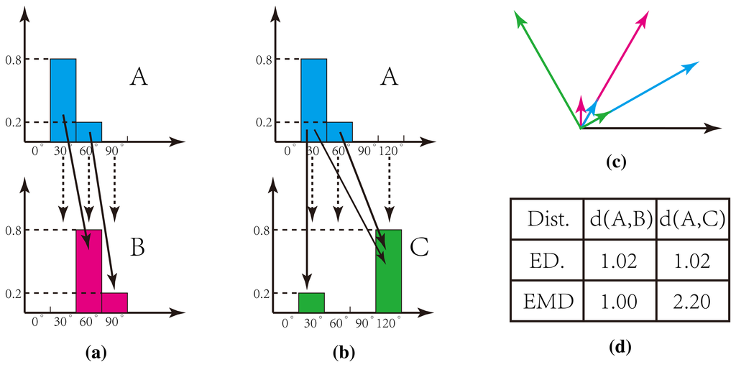
Earth Mover’s Distance

Slide 11
Transition Probability Matrix
$$p\left(G^{t+1} | G^{t}\right)=\prod_{i=1}^{n}{p({G_{i}}^{t+1}|G^{t})}$$
State | A | B | C
000 | 0 | 0 | 0
100 | 0 | 0 | 1
010 | 1 | 0 | 1
110 | 1 | 0 | 0
001 | 1 | 0 | 0
101 | 1 | 1 | 1
011 | 1 | 0 | 1
111 | 1 | 1 | 0
$${\tilde{T}}_{ij}=P({G_{j}}^{t+1}=1|G^{t}=i)$$
$$T_{ik}=\prod_{j=1}^{n}{\left[{\tilde{T}}_{ij}δ(k_{j}−1)+(1−{\tilde{T}}_{ij})δ(k_{j})\right]}$$

